Slide 1


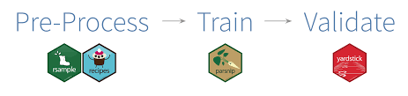

Modeling with Tidymodels
Dekut[R] MeetUp

Slide 2
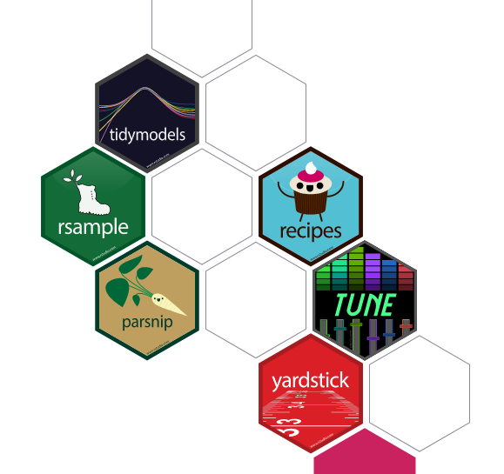
WHAT TIDYMODEL ENTAILS
Tidymodels is a powerful suite of R packages designed to streamline machine learning workflows
Open Rstudio

Slide 3

TIDYMODELS ECOSYSTEM
Assign each package within the tidymodels ecosystem to its corresponding process within the machine learning workflow.
Data resampling and feature engineering:
Model fitting and tuning:
Model evaluation:
Open Rstudio

Slide 4

Creating training and test datasets
ThE rsample package is designed to create training and test datasets.
Creating a test dataset is important for estimating how a trained model will likely perform on new data to avoid overfitting.
Open Rstudio

Slide 5
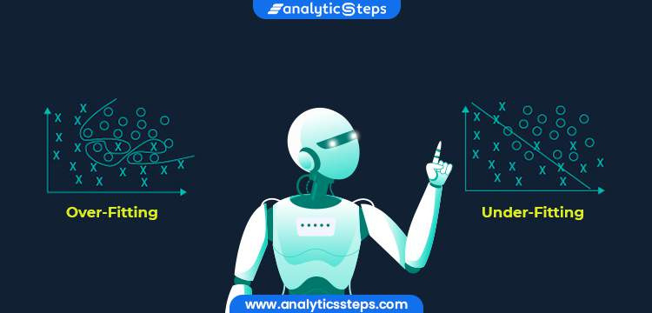
what is Overfitting?
HAPPENS where a model memorizes patterns that exist only in the training data and performs poorly on new data.

Slide 6
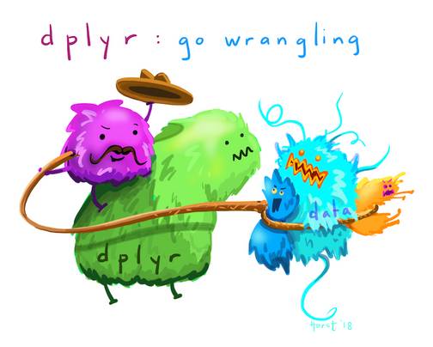
Distribution of outcome variable values (do some data wrangling usind dplyr)
Since the original data is split at random, stratification avoids placing all the expensive homes in home_sales into the test dataset, for example. In this case, your model would most likely perform poorly because it was trained on less expensive homes
Open Rstudio

Slide 7

Linear regression with tidymodels
The parsnip package provides a unified syntax for the model fitting process in R.
With parsnip , it is easy to define models using the various packages, or engines, that exist in the R ecosystem.
Open Rstudio

Slide 8

Exploring estimated model parameters
USING YARDSTICK WHICH IS A PACKAGE FROM THE TIDYMODELS UNIVERSE
Open Rstudio

Slide 9

Predicting home selling prices
After fitting a model using the training data, the next step is to use it to make predictions on the test dataset. The test dataset acts as a new source of data for the model and will allow you to evaluate how well it performs.
Open Rstudio

Slide 10

END
PRESENTER:
Karani Wachira
TWITTER
@mrAfricanSeed
LINKEDIN
Karani Wachira
SOURCE: TRAN THANH DAT - INTERNATIONAL UNIVERSITY ON RPUBS
ART SOURCE: ALLISON HORST

